Slide 1

Polycystic ovary syndrome (PCOS) Classification
DATA SCIENCE FINAL PROJECT
TEAM LIFT
C. Gee

Slide 2
PCOS
PCOS is a hormonal disorder common among women of reproductive age. Women with PCOS may have infrequent or prolonged menstrual periods or excess male hormone (androgen) levels. The ovaries may develop numerous small collections of fluid (follicles) and fail to regularly release eggs.

Slide 3

Knowing our Dataset
The dataset contains total 45 columns, out of 45 columns 19 columns has float data type, 23 columns have integer data type and 3 columns have object data type.
Targe column has 2 outputs 0 and 1. 1 for PCOS positive and 0 for PCOS negative.

Slide 4
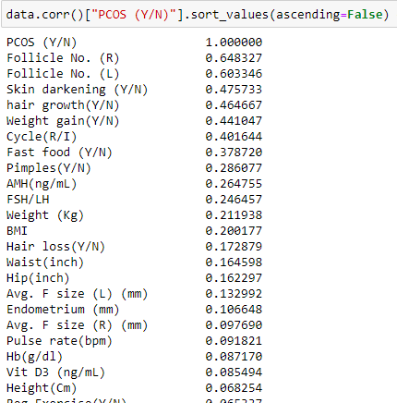
Exploratory Data Analysis (EDA)
Displaying columns which are correlated with PCOS
Follicle No.(R)
Follicle No. (L),
Skin Darkening
Hair Growth
Weight Gain,
Cycle (R/I)

Slide 5
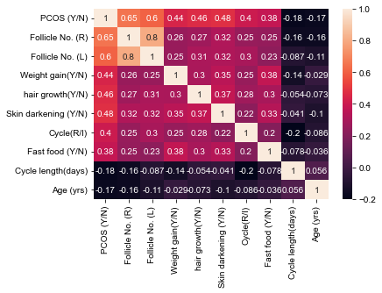
Question 1 Visualize the correlation of columns
Visualizing the Heatmap of Correlated features

Slide 6
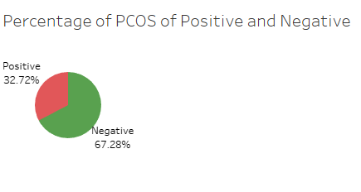
Question 2 How many people are PCOS Positive?
In our dataset 32.72% are PCOS positive

Slide 7
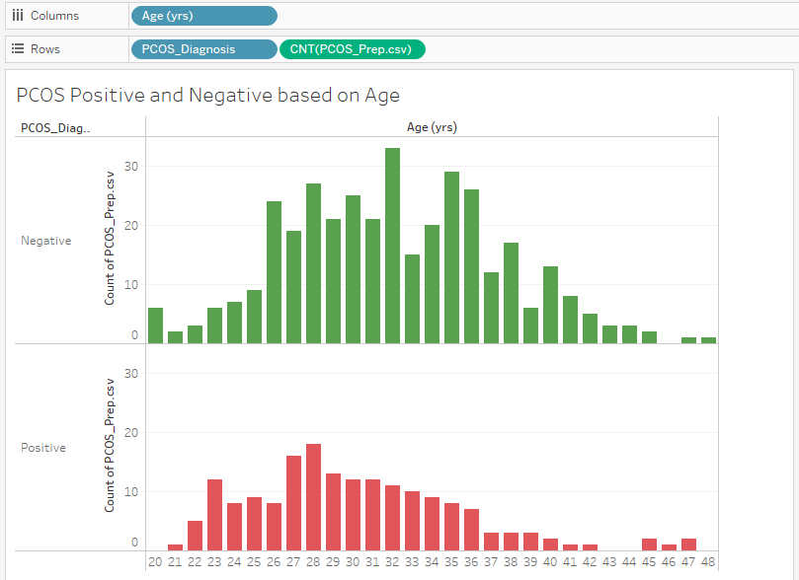
Question 3 What is the trend of PCOS with Age
Visualizing the Age trend with PCOS positive and PCOS negative

Slide 8
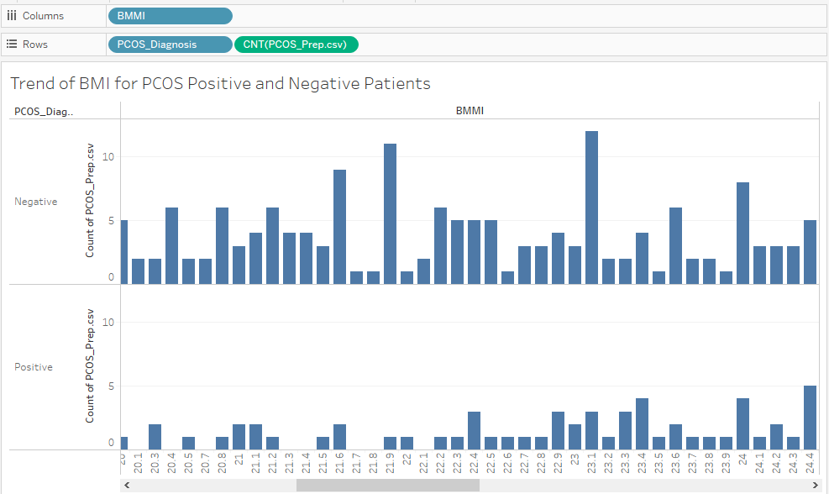
Question 4 What is the trend of PCOS with BMI
Visualizing the trend of BMI with PCOS

Slide 9
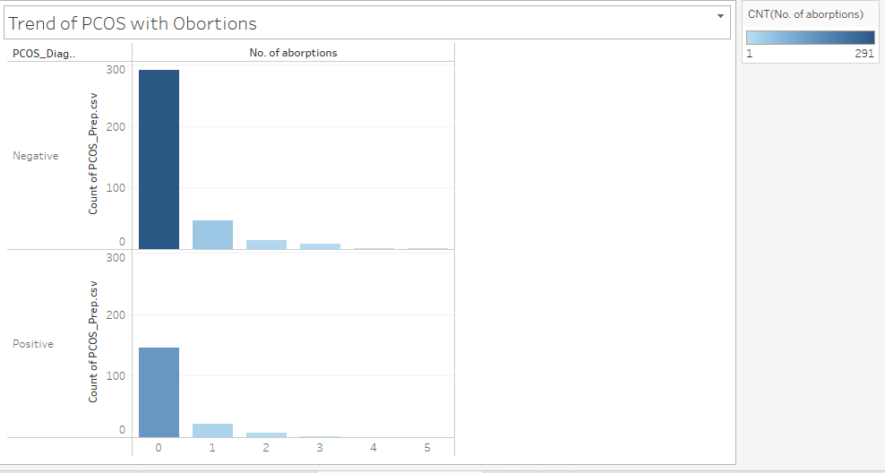
Question 5 What is the trend of Abortions with PCOS
Visualizing the trend of No of abortions with PCOS

Slide 10
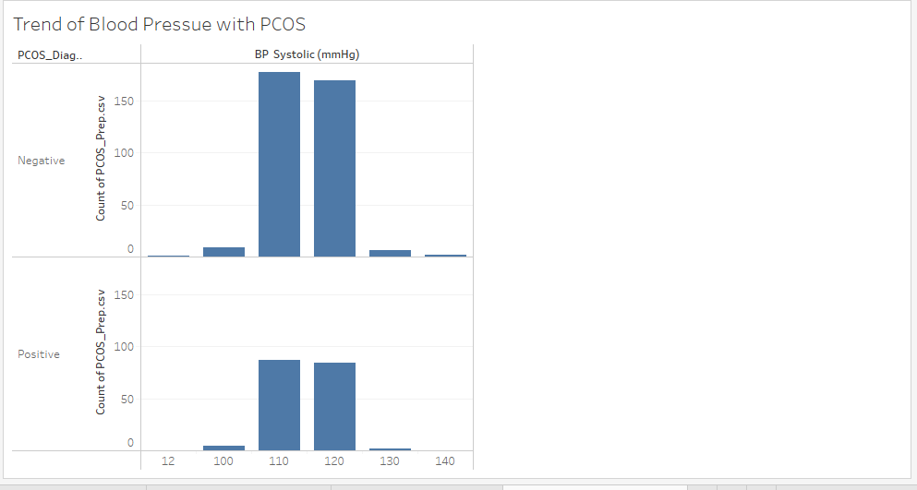
Question 6 What is the trend of Blood Pressure(BP) with PCOS
Visualizing the trend of BP systolic (mmHg) with PCOS

Slide 11
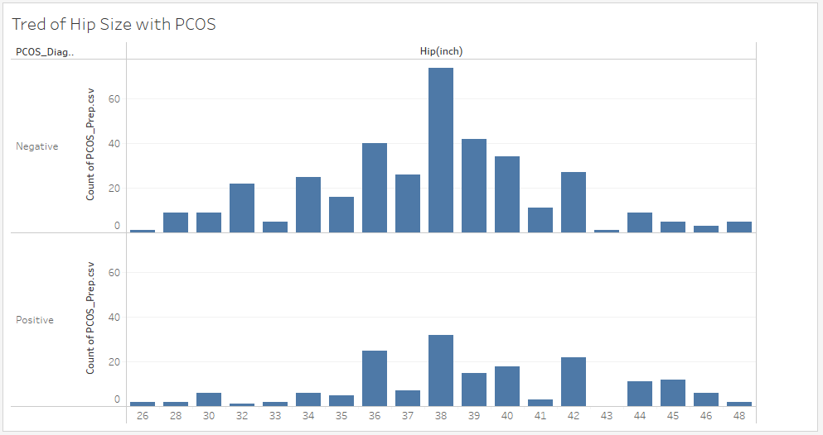
Question 7 What is the trend of Hip size with PCOS
Visualizing the trend of Hip(inch) with PCOS

Slide 12
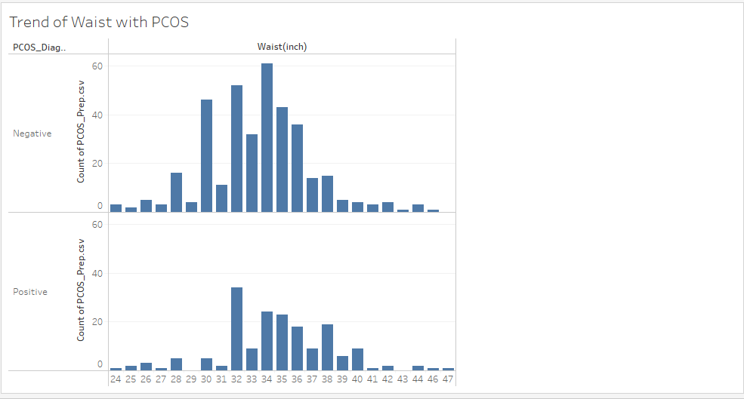
Question 8 What is the trend of Waist with PCOS
Visualizing the trend of Waist(inch) with PCOS

Slide 13
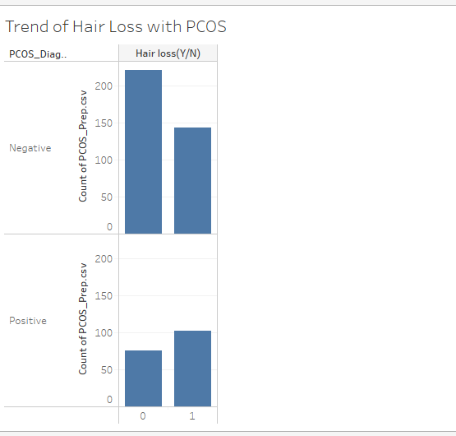
Question 9 What is the trend of Hair Loss with PCOS
Visualizing the trend of Hair loss (Y/N) with PCOS

Slide 14
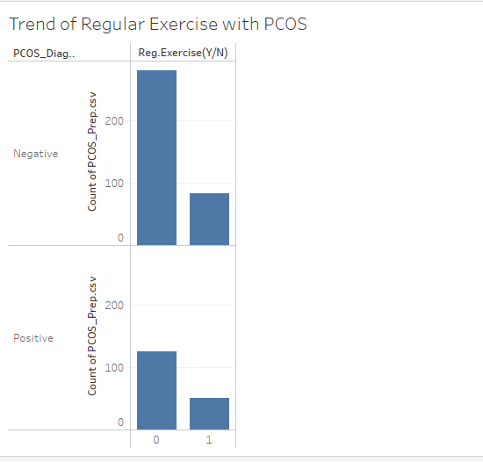
Question 10 What is the trend of Regular Exercise with PCOS
Visualizing the trend of Reg Exercise (Y/N) with PCOS

Slide 15
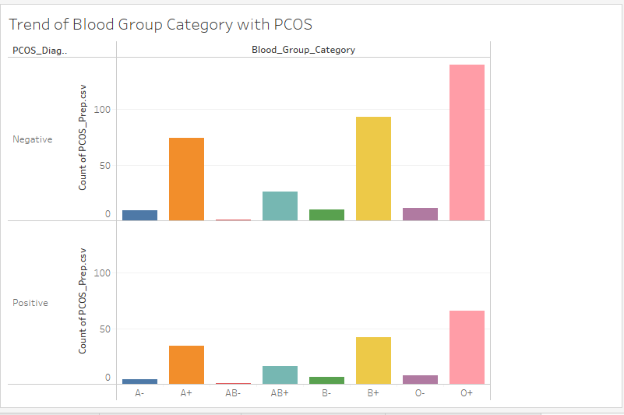
Question 11 What is the trend of Blood Group with PCOS
Visualizing the trend of Blood Group Category with PCOS

Slide 16
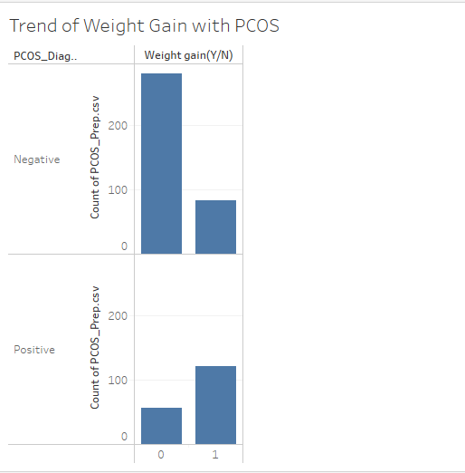
Question 12 What is the trend of Weight Gain with PCOS
Visualizing the trend of Weight Gain (Y/N) with PCOS

Slide 17
Statistical Testing
After performing Data Analysis we observed the symptoms of PCOS disease. In Statistical Testing we are going to test few symptoms are these symptoms are statistically important to cause PCOS
Applying Chi-Square Test on
Hair Growth
Weight Gain Columns

Slide 18
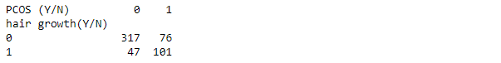
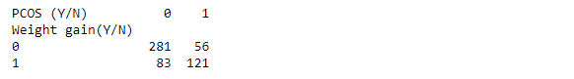
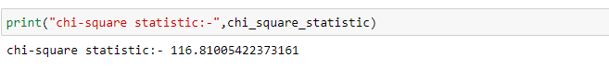
Statistical Testing
Creating contingency tables
Calculating Chi-square value
After performing Chi-Square test on both variables it is clear that both columns has significance in PCOS disease prediction.
Variable | Chi-Square Value
Hair Growth (Y/N) | 116.8100
Weight Gain (Y/N) | 105.23677

Slide 19
Conclusion
According to Correlation test, Exploratory Data Analysis and Statistical Testing it is proved that Follicle No (R), Follicle No (L), Weight Gain (Y/N), Hair Growth (Y/N), Skin Darkening (Y/N), Fast Food (Y/N), Cycle Length(days) only these columns are significant for the prediction of PCOS disease.

